Slide 1

Selected 2 Project Presentation
Team 38

Slide 2
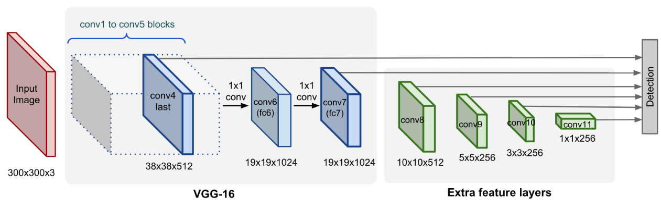
SDD: Single Shot Multi-Box Detector
SSD uses the VGG-16 model pre-trained on ImageNet as its base model for extracting useful image features. On top of VGG16, SSD adds several conv feature layers of decreasing sizes. They can be seen as a pyramid representation of images at different scales. Intuitively large fine-grained feature maps at earlier levels are good at capturing small objects and small coarse-grained feature maps can detect large objects well. In SSD, the detection happens in every pyramidal layer, targeting at objects of various sizes.

Slide 3
Obstacle-dataset OD Classes ["stop_sign","person","bicycle","bus","truck","car","motorbike","reflective_cone","ashcan","warning_column","spherical_roadblock","pole","dog","tricycle","fire_hydrant"]
This obstacle dataset follows the format of the VOC dataset
The dataset contains xml files in VOC format and .txt files for yolo training, as follows.
-JPEGImages -Annotations -ImageSets --Main ---train.txt ---test.txt ---val.txt According to pictures and labels, as follows. img-train for training Contains 5066 images ann-train img-test for test Contains 1583 images ann-test img-val for validation Contains 1266 images ann-val

Slide 4
Hyperparameters
Learning Rate: 0.001
Decay lr at: [0.7, 0.85]
Weight decay: 5e-4
Number of train Iterations: 4000
Input image size: (300X300X3)
Use pretrained vgg16 weights
Batch size: 8
Epochs = number of train iteration // dataloader.length
Batch normalization flag
Optimizer: SGD

Slide 5
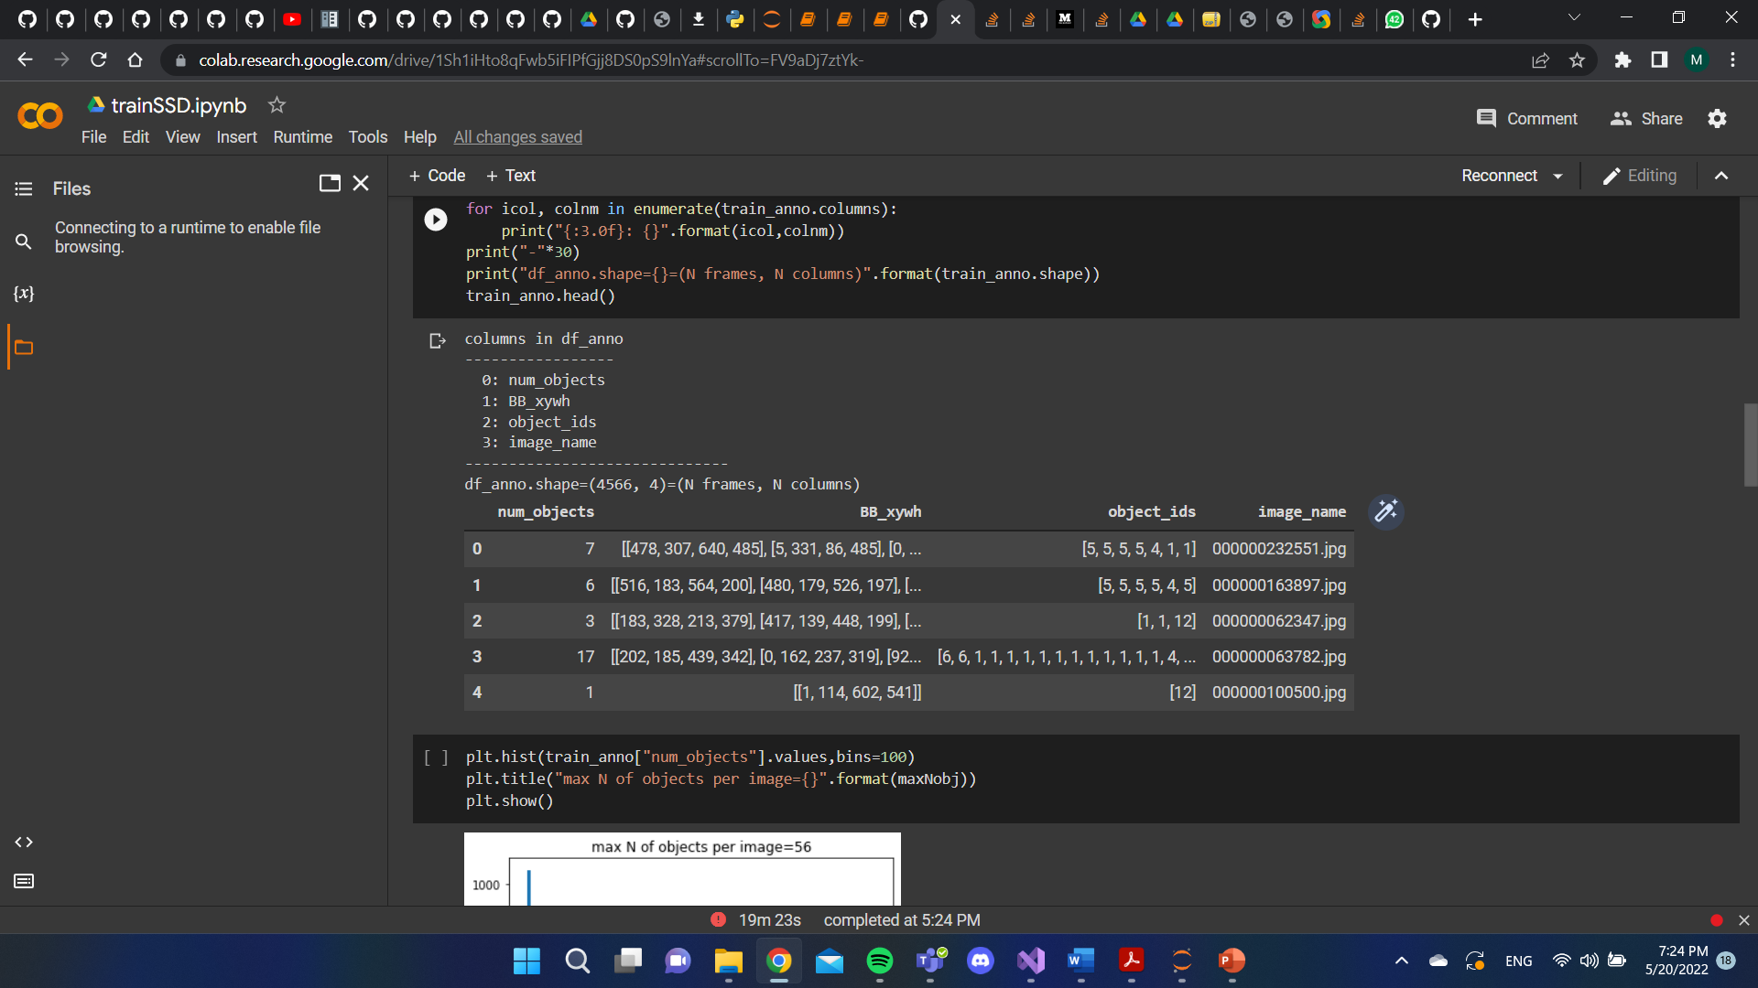
Dataset after preprocessing

Slide 6
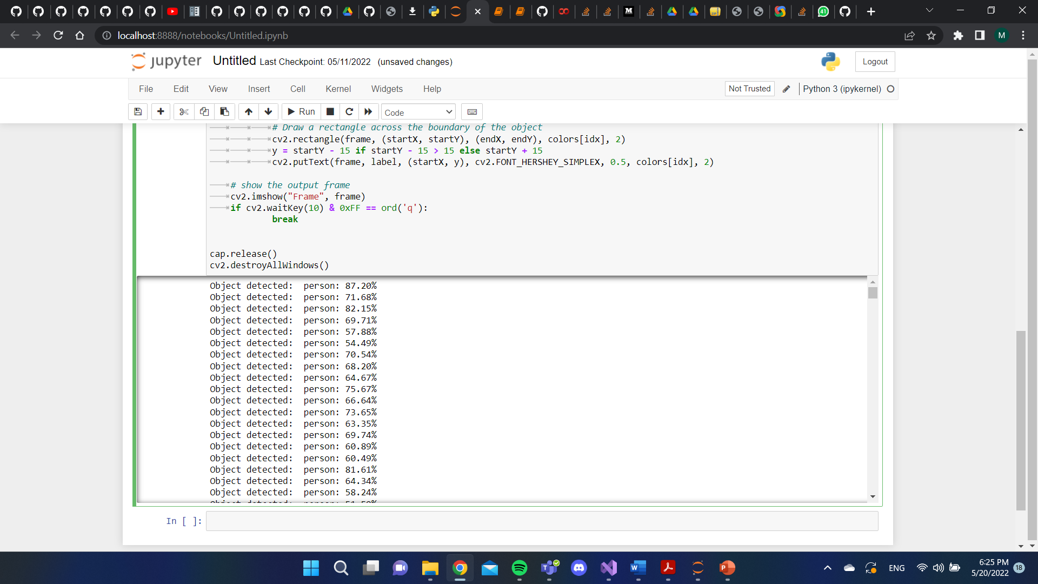
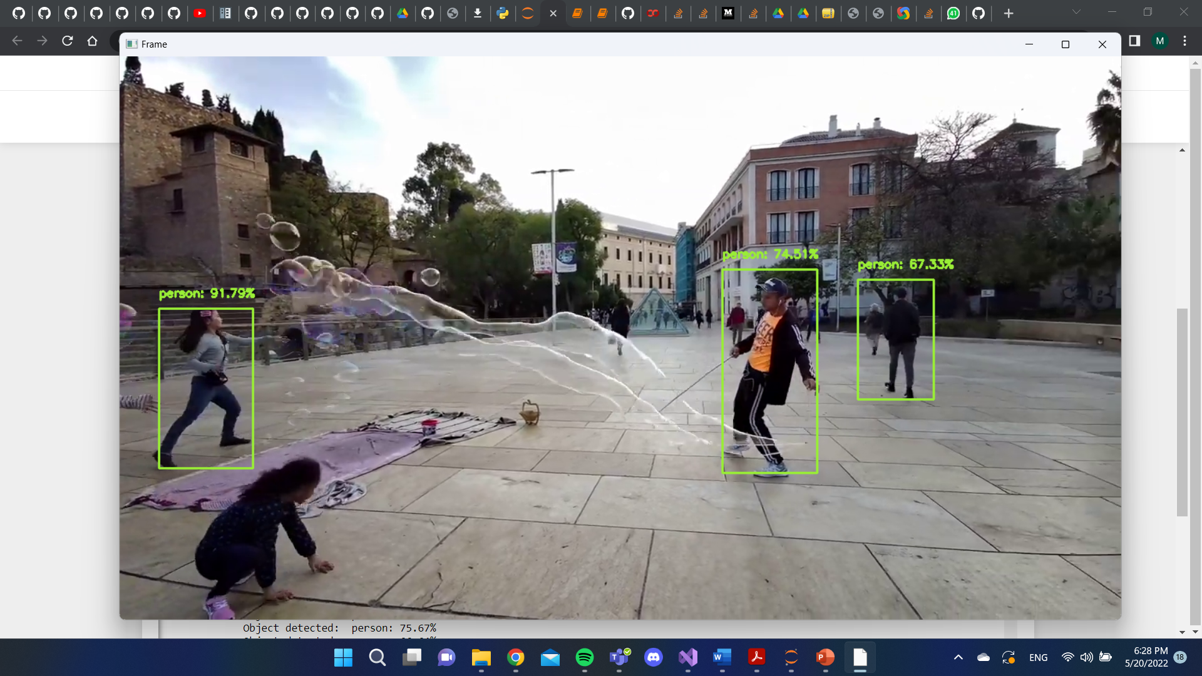
Results kindly please read “readme.doc”

